Slide 1

MALARIA PARASITE DETECTION AND WARNING SYSTEM USING DEEP LEARNING
CAPSTONE PROJECT – NNDL COURSE
TEAM 21
18K41A0505 AREEFA
18K41A0415 G.LEENA
18K41A0556 SRIABHINAY
18K41A0232 SAIFUDDIN
MENTOR – Mr. S Naresh

Slide 2
Problem Statement
To develop a Model that could help in detecting the Malarial Parasite in blood samples and in addition to that building a warning system to prevent the outbreak of Malaria.

Slide 3
Introduction
Health care is the major field that needs the implementation of technologies to make it more feasible and more accessible to the people to take preventive steps for protecting themselves from the epidemic diseases
Malaria, one of the world's most dangerous infectious illnesses and a leading cause of public health concerns, affects over two-thirds of the whole world's population, resulting in an estimated million fatalities each year.

Slide 4
Need Of Project
The most widely used method (so far) is examining thin blood smears under a microscope, and visually searching for infected cells. The patients’ blood is smeared on a glass slide and stained with contrasting agents to better identify infected parasites in their red blood cells.
Time consuming and Human errors by microscope technicians
As we know that, Malaria breeds have a high capability to grow easily in humid certain temperatures. Thus, the weather conditions influence the outbreak of malaria, and whereby it is very important to tell the daily outbreak consequences to the people based on the climate in their areas.

Slide 5
Objectives
To create an efficient deep learning model for detecting the malaria parasites in the blood samples easily at laboratory level.
Compare the existing models with our custom model.
To develop a Malaria Outbreak warning system for the users to warn them about the outbreak.
The Outbreak system model must be using logistic regression which should be implemented using Gradient Descent Algorithm.
A Web-App for the deployment of the models.

Slide 6
Beneficiaries
The Custom CNN model that we had implemented helps in predicting the accurate results as we got the highest accuracy than the other existing models.
Laboratory Level: The malaria detection web app where we deployed our model helps at laboratory level in the examination of blood cells fast and accurately just by uploading the images.
Communities – people: Helps users to check out the weather conditions and get warned about the risk of a Malaria outbreak through our Web App.
Hence, different use cases over the same web app with efficiently trained models running in the backend make our work significant.

Slide 7
DATASETS FOR TWO MODELS

Slide 8
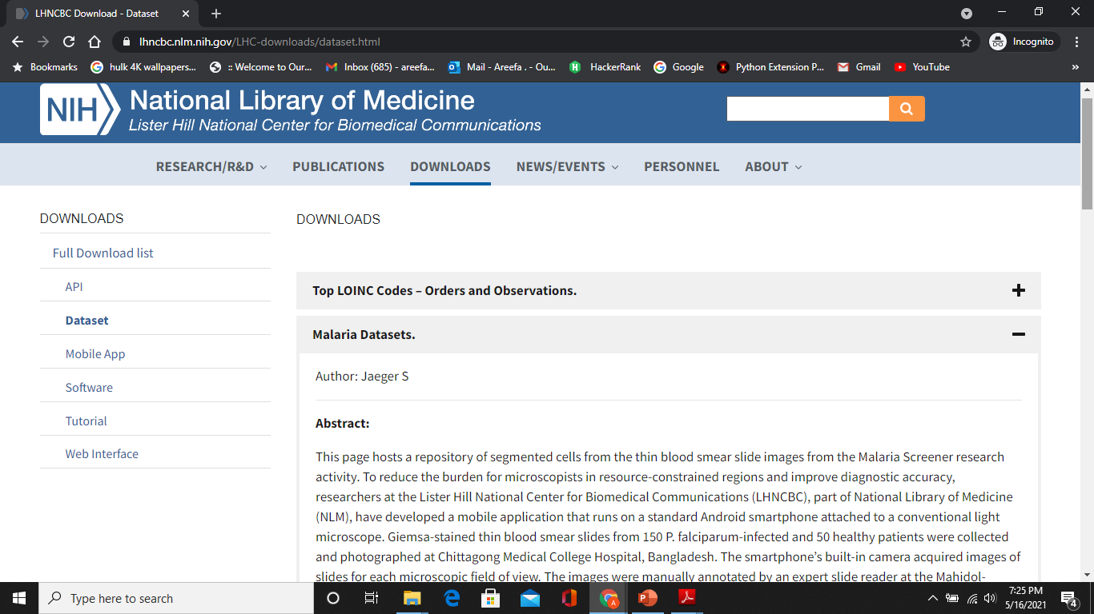
MODEL 1: Dataset – Malaria Detection(Laboratory level)
NIH has a malaria dataset of 27,558 cell images with an equal number of parasitized and uninfected cells.
A level-set based algorithm was applied to detect and segment the red blood cells. The images were collected and annotated by medical professionals.

Slide 9
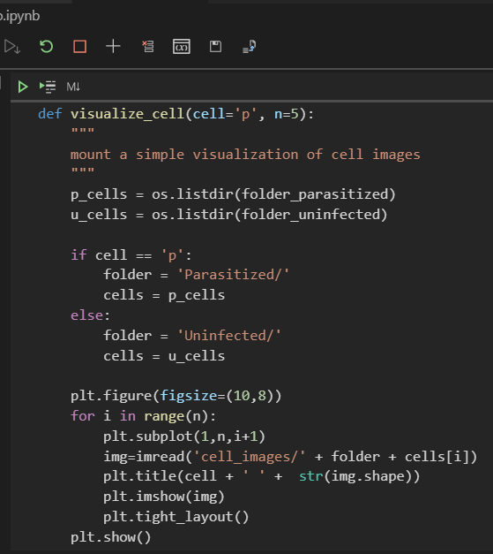
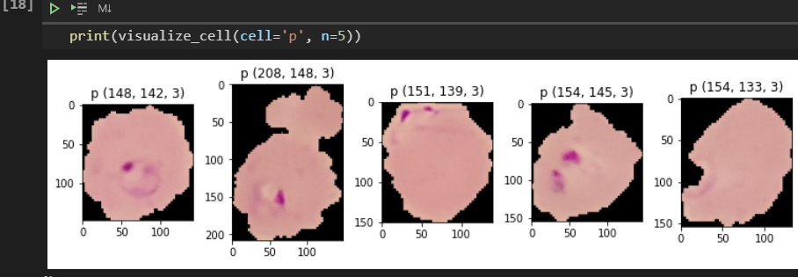
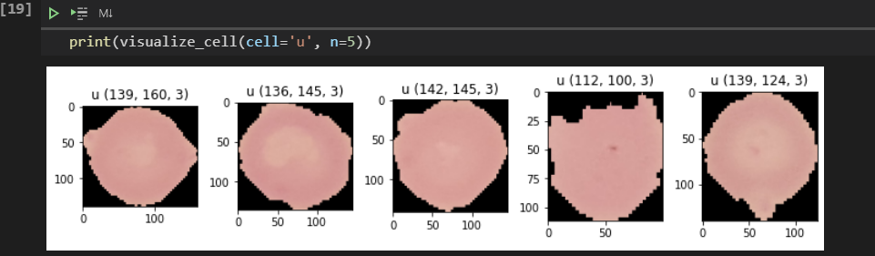
VISUALIZING DATASET

Slide 10
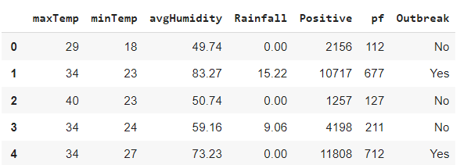
MODEL 2:
Malaria Outbreak Dataset
The dataset consists of one of the most important factors that can influence the success or failure of an outbreak prediction model. The information was gathered from a variety of sources, including the National Vector Borne Disease Control Program in Pune and Indian Meteorologic AL's meteorological data.
The dataset has 22 records with 7 column features as shown in the below figure. Prediction of Outbreak Class – Yes or No.

Slide 11
EXISTING WORKS
MALARIA PARASITE DETECTION MODEL:
Starting with the work contributed Anggraini et al. where an application been developed that could automatically apply the image segmentation methodologies over the input images such that the blood cells would be separated from the background. This created many people to consider these images and build the models.
In some scenarios, the traditional methods of neural networks which are familiar as multilayer perceptron (MLP) are proposed which depict the human brain whereby the connected neurons will be stimulated only when a certain defined threshold value invokes.
Many had proposed with different models like VGG-16, Xception, ResNet-50, and AlexNet and compared them. We used their comparisons to analyze the models.
Some research papers had proposed the simpler models of CNN and even used SGD optimizer. Though the model got the sound training accuracy, it failed at the validation of the images of the blood cell smears by giving the false prediction of Infected though the actual label was Uninfected.
Problems Observed by us:
Though many of the works concluded that the transfer learning models performed well and retained better results than the custom models, these required feature extraction and many numbers of model parameters to be trained that lag with time consumption.
All these constraints make the model more complex in size which cannot be easily deployable over any devices like IoT or smartphone applications.

Slide 12
Existing Works
MALARIA OUTBREAK SYSTEM
In the works, support vector machine and even artificial neural networks were used. In this basic work, Support Vector Machine (SVM) and Artificial Neural Network (ANN) were used for Malaria prediction over the dataset of outbreak Maharashtra state. Authors showed how the misleading of the wrong prediction of an outbreak due to directly applying SVM through they got 77% accuracy. Some used medical-based intelligence, which reports the locations by highlighting the risk of an outbreak.
Problems we observed:
The malaria outbreak detection was done based on the weather parameters but in most of the cases, as the dataset is small, it couldn’t produce the efficient training which was observed in the current works.
All these works showed less training accuracy relatively which gives the false prediction of the outbreak. Thus, there is a need of building the model with custom weights such that with less dataset even, it could be efficiently be trained to give accurate prediction over the real-time weather forecast.

Slide 13

OUR PROPOSED MODELS & DL TECHNIQUES CODE DISCUSSION

Slide 14

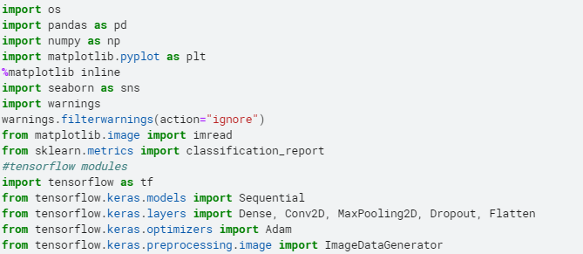
Framework and Libraries
Keras is just an interface that allows you to easily access and customize the backend machine learning frameworks like TensorFLow.
Directly using these frameworks are complex. Thus, many prefer a high-level API such as Keras to run on top of them mainly in Neural networks.

Slide 15
STEPS FOLLOWED
Why CNN?
Deep learning, there are several types of models such as the ANN, RNN, reinforcement. But there has been one particular model that has contributed a lot in the field of computer vision and image analysis which is the Convolutional Neural Networks (CNN)
Read
Read the dataset after downloading.
Pre-process
Pre-process the images (resize)
Develop
Develop CNN model
Compile
Compile CNN model (optimizer = ‘adam’ and specify metrics)
Train & validate
Train & validate the model
Test/ Predict
Test/ Predict the trained model
Compare
Compare accuracies (training & testing)
Deploy
Transform Trained model into Deployable model to build an application.

Slide 16
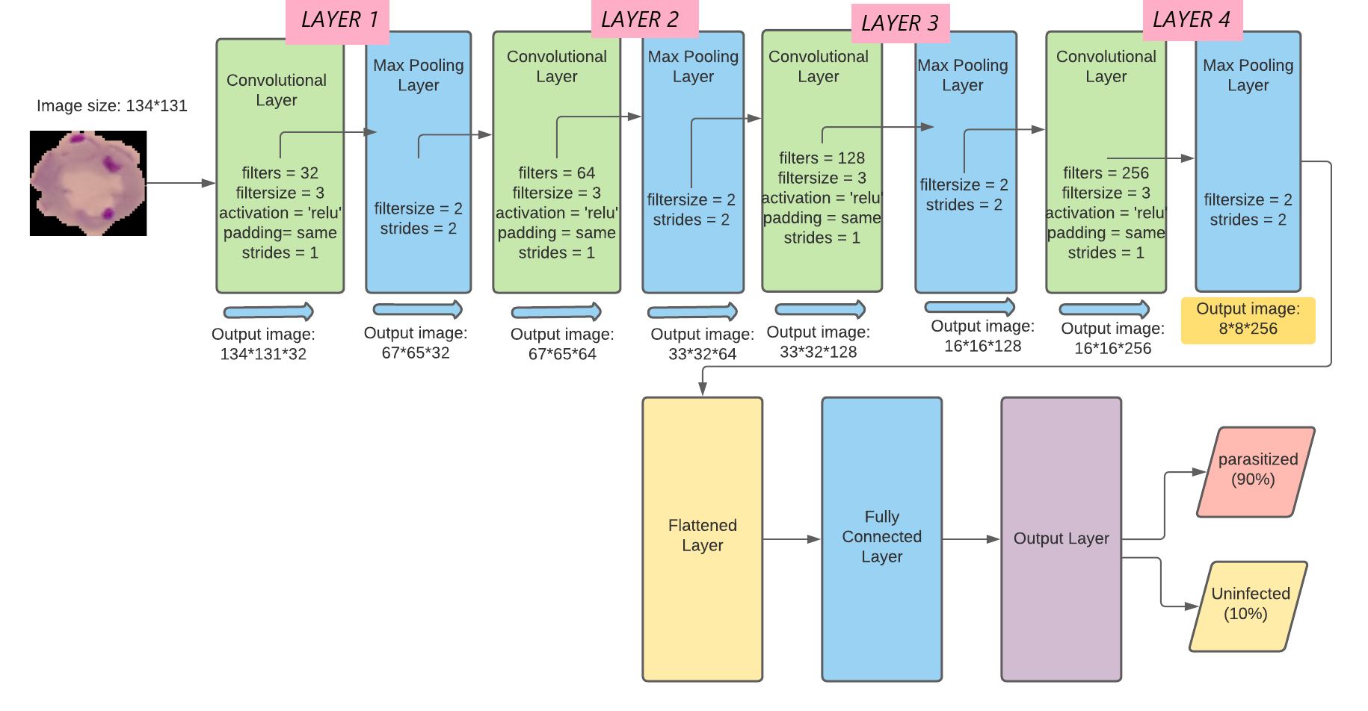
CUSTOM CNN ARCHITECTURE – MODEL 1
The proposed model by us is based built according to the main blocks of CNN as shown below:
Input Image
Convolutional Layers
Activation Function – ReLU
Max Pooling Layers
Flattening Layer
Fully Connected Layer
Output Layer

Slide 17
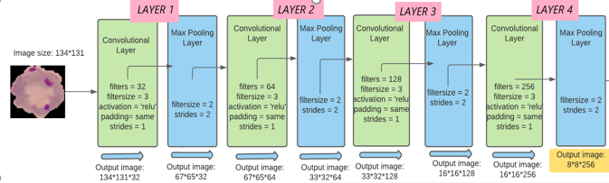
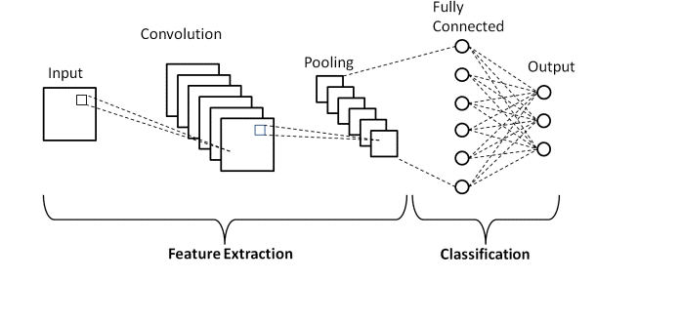
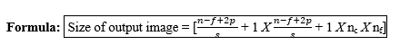
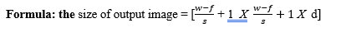
Layers Responsible for Feature Extraction
Operational params:
CONVOLUTIONAL
Operation | Filter size (f) | Number of filters (nf) | Strides (s) | Padding (p) | Output image size
1 | (3, 3) | 32 | 1 | same | (134, 131, 32)
2 | (3, 3) | 64 | 1 | Same | (67, 65, 64)
3 | (3, 3) | 128 | 1 | Same | (33, 32, 128)
4 | (3, 3) | 256 | 1 | Same | (16, 16, 256)
Operational Parameters: MAX POOLING
Operation | Filter size | Number of strides | Size of input to input to pooling layer | Depth of input to pooling layer | Output image size
1 | (2, 2) | 2 | (134, 31) | 32 | (67, 65, 32)
2 | (2, 2) | 2 | (67, 65) | 64 | (33, 32, 64)
3 | (2, 2) | 2 | (33, 32) | 128 | (16, 16, 128)
4 | (2, 2) | 2 | (16. 16) | 256 | (8, 8, 256)

Slide 18
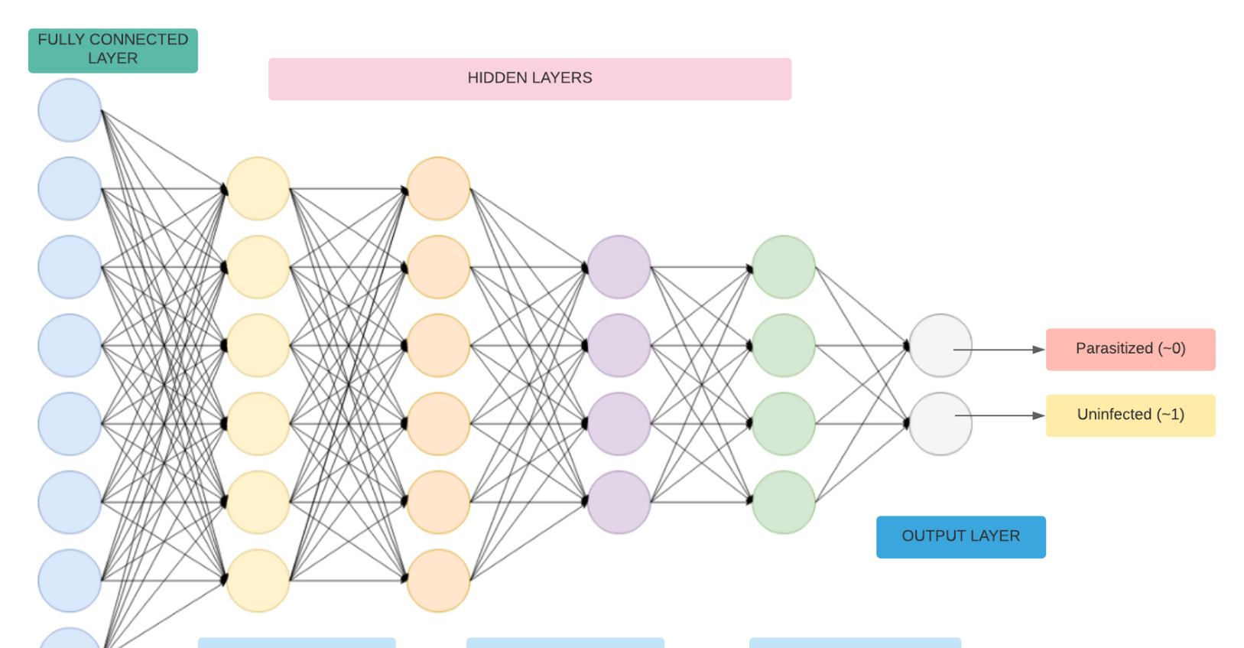
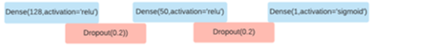
Layers responsible for Classification

Slide 19
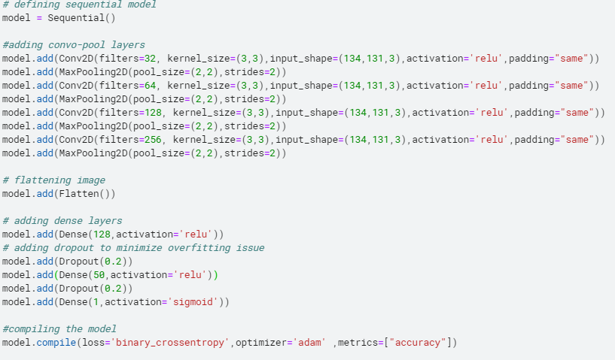
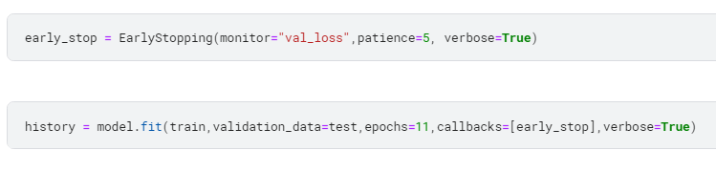

Slide 20
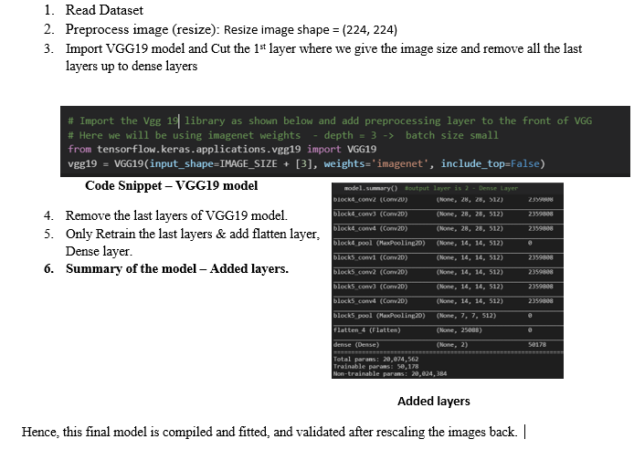
TRANSFER LEARNING MODEL – VGG19
Transfer learning models are already trained in the classification of 1000’s classes. We can directly use them by tuning the classes according to our needs.

Slide 21
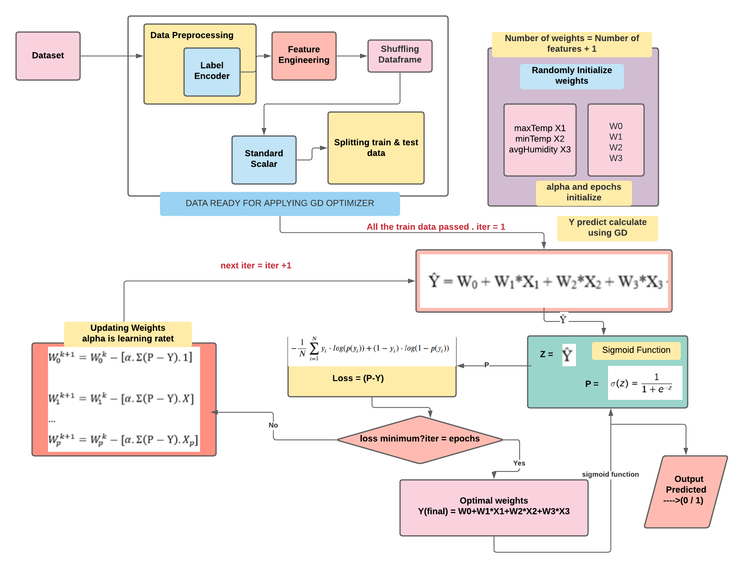
MODEL 2: MALARIA OUTBREAK PREDICTION
To predict the Outbreak of malaria based on the weather condition, we had applied Logistic Regression without using the scikit-learn library. Instead, we had applied the GD (Gradient Descent) Optimizer and predicted the outbreak probability.

Slide 22

RESULTS DISCUSSION

Slide 23
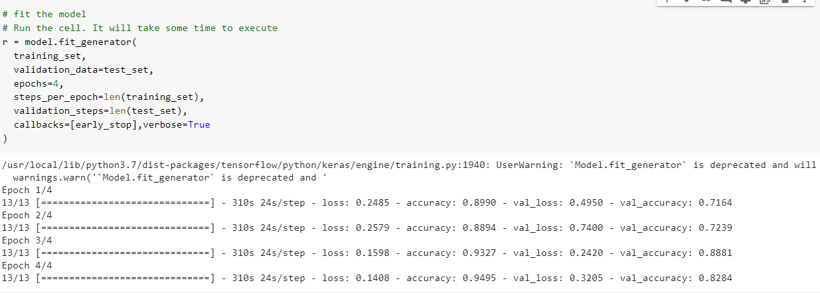
VGG 19 model
CUSTOM CNN MODEL

Slide 24
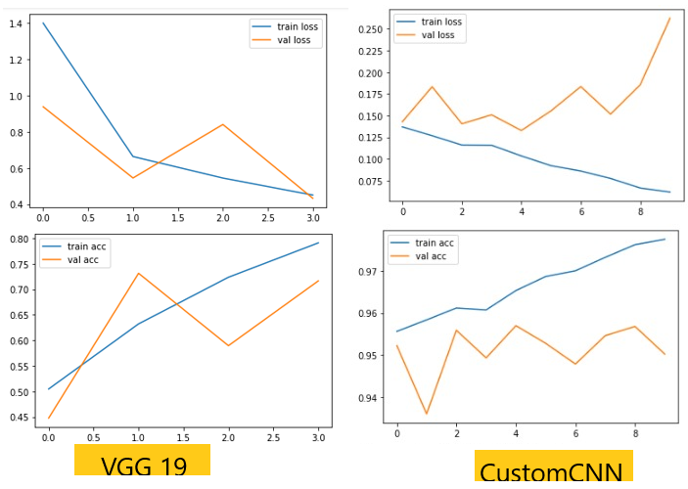
Comparison
When we compare both models at epochs 0f 4, we can easily find that about 97.74% of training accuracy is obtained by our custom CNN model which is higher than the VGG19 model.
Even validation accuracy is about 95.7% at the 4th epoch for the Custom CNN model which is higher than that of the VGG19 model. Even the training and validation loss depicts the same.

Slide 25
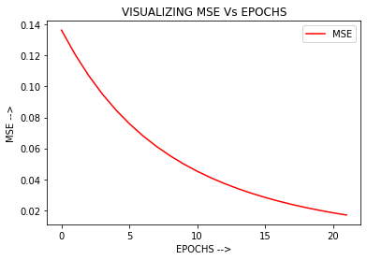
Our Malaria Outbreak Prediction model
ACCURACY OBTAINED IS 83% far higher than the existing models.
(Though the dataset is very small)

Slide 26


WEB APP
FLASK APP
OPEN WEATHER API
HEROKU
This Flask App is deployed over Cloud platform - Heroku. Heroku is a container-based cloud Platform
Hosted Malaria Outbreak website link:
Manual Weather Inputs by user: https://malariaoutbreak-manualinputs.herokuapp.com/
Open Weather API live weather - based Outbreak prediction:
https://malariaoutbreak-ml.herokuapp.com/

Slide 27
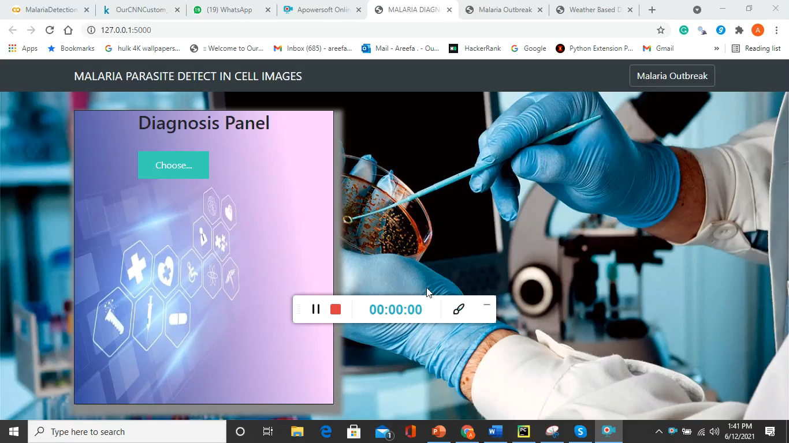

Slide 28
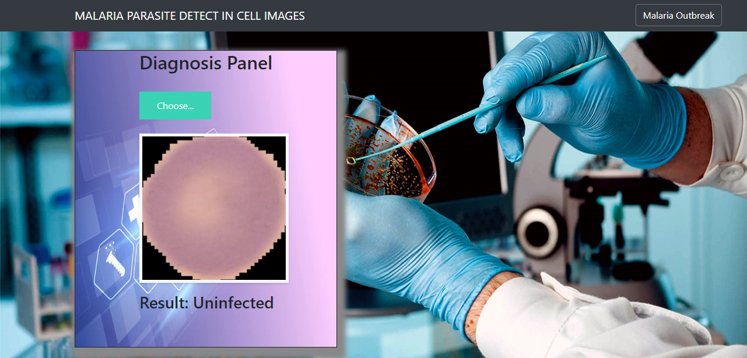
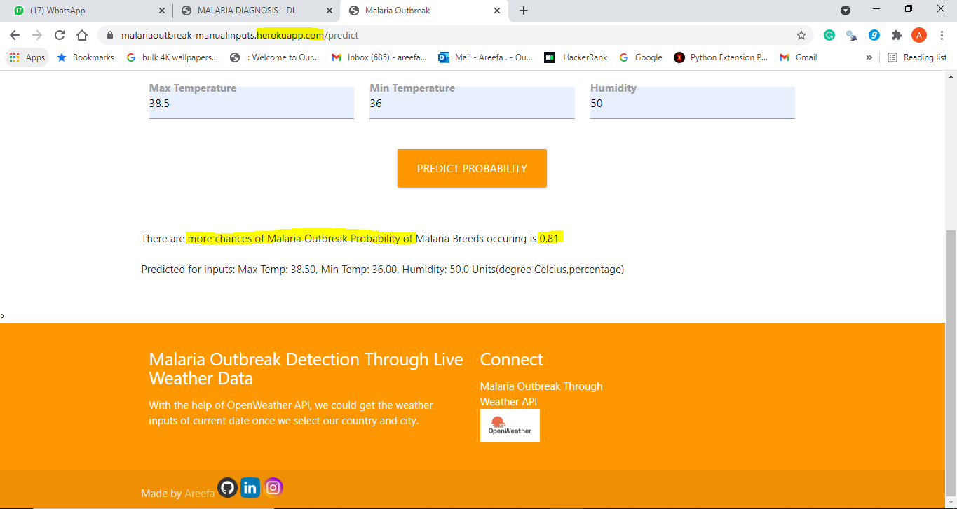
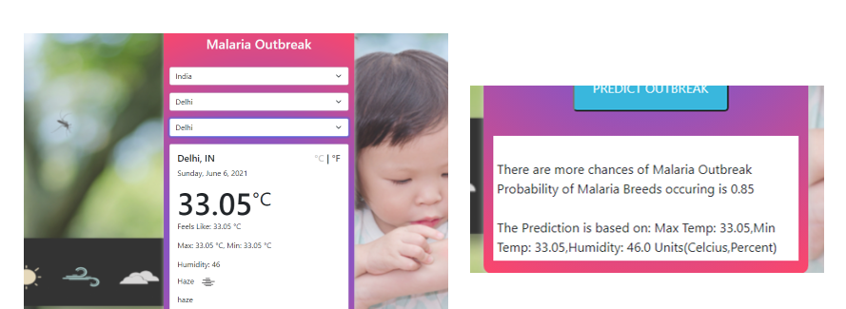
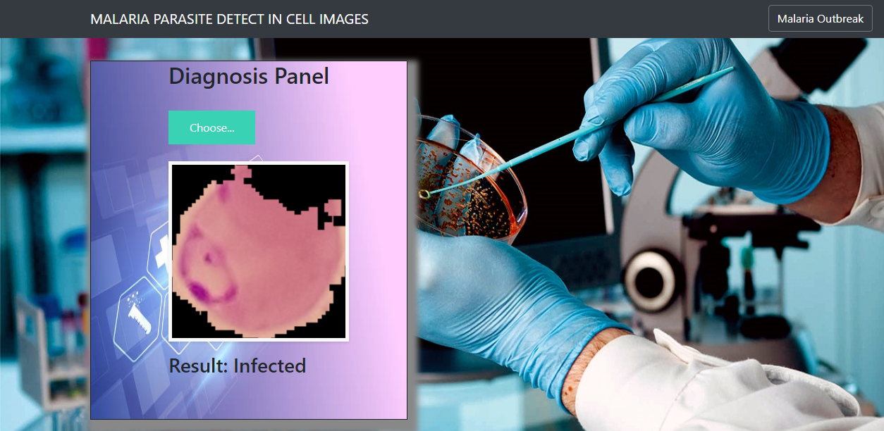

Slide 29
Conclusion & Future Scope
Our Custom CNN model proposed by us performs well by considering important parameters. It is simpler and can be easily deployable.
The Outbreak system gives accurate predictions over the live weather forecast data.
Thus, our proposed system which is deployed as a flask app and hosted over Heroku, helps users to check out the weather conditions and get warned about the risk of a Malaria outbreak. On other hand, the malaria detection web app helps in the examination of blood cells fast and accurately just by uploading the images. Hence, different use cases over the same web app with efficiently trained models running in the backend make our work significant.
FUTURE SCOPE:
There is no limit for the CNN models. There is more scope in the medical field as we get real-time data. The work can be extended by experimenting with the changes in the custom CNN model.
There is more scope to create the dataset with the help of weather API. It would help in coming up with efficient models that help in predicting the outbreak of various diseases that get influenced by the weather conditions.
Extend the web app with different disease predictions that rely on the CNN model at the laboratory level.

